Slide 1
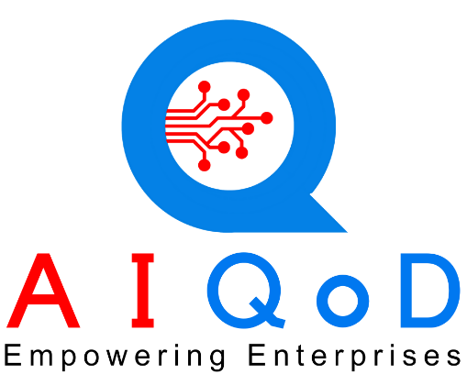
AIQoD360 Super App - Smart Digital Enterprise Empowering Enterprises through AI Agents

Slide 2
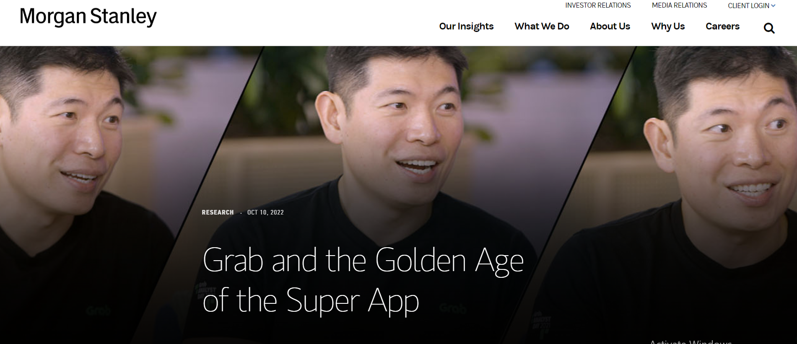
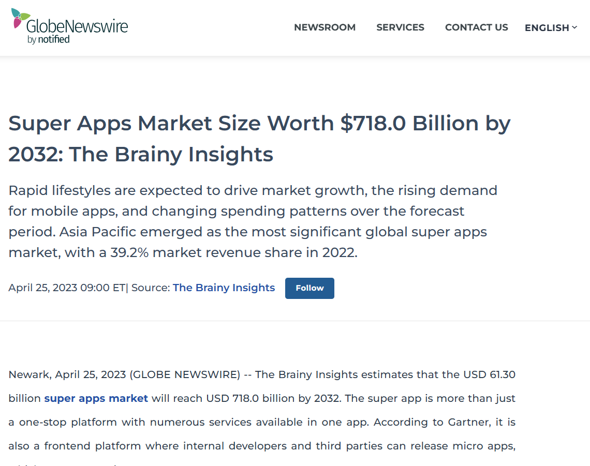
Rise of Super Apps

Slide 3
Enterprise Challenges
Lack of seamless experience
Technology is moving too fast
R&D
Maintenance
Multiple Applications
Multiple dashboards
Multiple User interactions
Data residing in multiple systems
Cost of Implementing New Technology
Distributed Operations
Cost of Labor
Scaling up

Slide 4
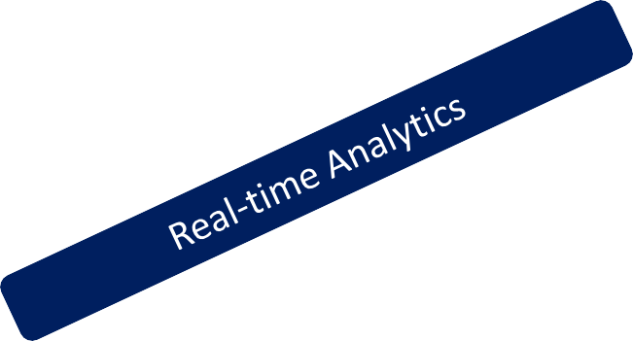
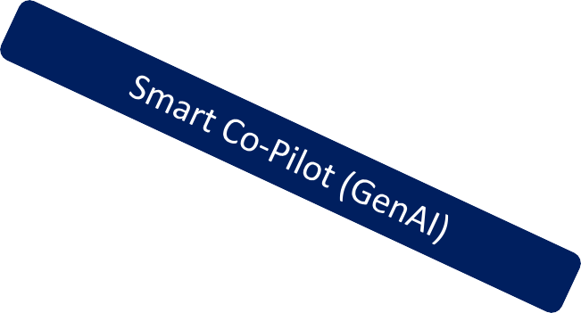
360º Transformation of an Enterprise
Sales
Marketing
Finance
AIQoD 360 is a pool of AI Agents for every function in an Enterprise.
A Super App with group of AI Agents which compliments with ERP platforms and transforms your enterprise into a
Smart Digital Enterprise.
Production
Accounting
Smart
Digital
Enterprise
Supply chain
Administration
Support
HR
Procurement
Training
GenAI Rule Engine No Code Studio Analytics Engine IDP/IIP DMS
Security ML Builds Multi-Lingual Offline Mode OS/Device

Slide 5
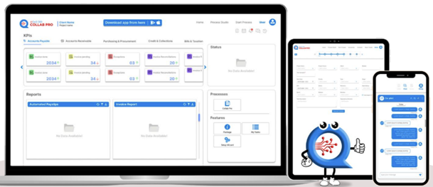
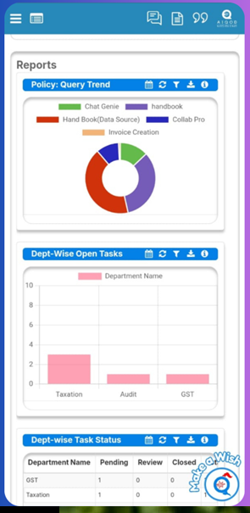
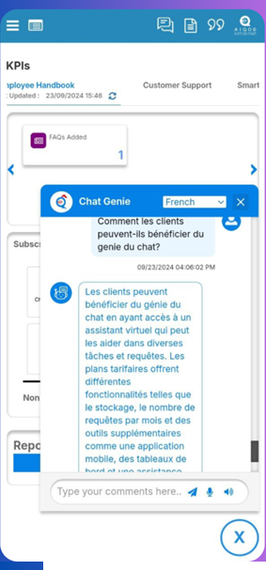
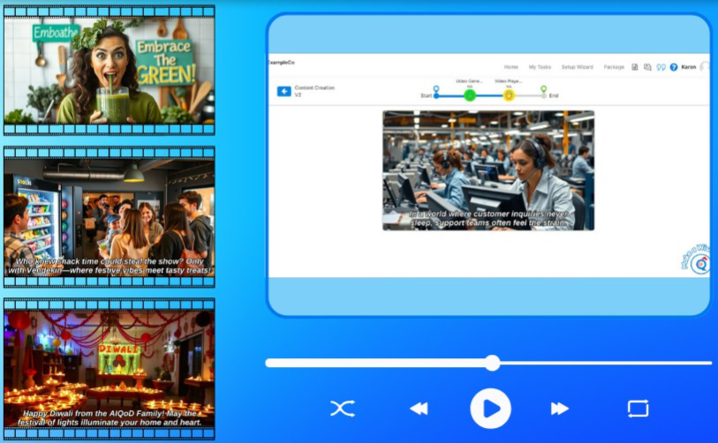
All-in-One Super App

Slide 6
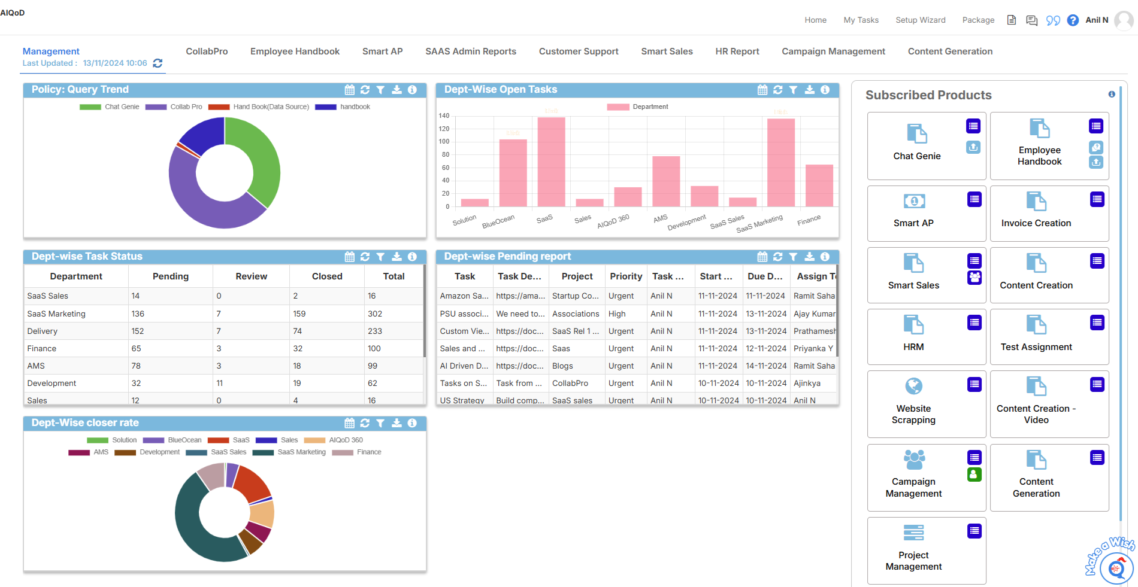
AIQoD 360 Super App

Slide 7
Subscription
Usage-based pricing
Revenue from product
In App product purchases
Business Model for a Scalable Global Enterprise
Low-Cost Entry Pricing Model and automatic Platform Scaling as your grow
ZERO capex and choose Products based on Need
Integrated Dashboard/Virtual Assistant
Anywhere/ Any Time/ Any Device/ Any Language
Monthly New Product Release with a planned roadmap of 14 products

Slide 8
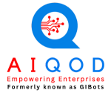
Thank You
Top 30 Startups
Top 15
Finalists
Top 34
(~500 participants)
Top 250
(~2500 participants)
Proud Partner of
Intel AI Builder
Winner
(~1000 participants)
www.aiqod360.com
anil@aiqod.com
+91 8888500058

