Slide 1
How to Make Your Website Talk
Transforming Websites with Conversational AI
Presented by AIQoD 360

Slide 2
Welcome & Introduction
Welcome everyone!
Speakers
Today's webinar will cover:
Pallavi, Moderator
The evolution of websites
Mr. Anil Nair, CEO, AIQoD 360
How conversational AI transforms engagement
Mr. Ajay Kumar, Sales Head, AIQoD 360
Live demo of Chat Genie
Interactive session with polls & hands-on activities

Slide 3
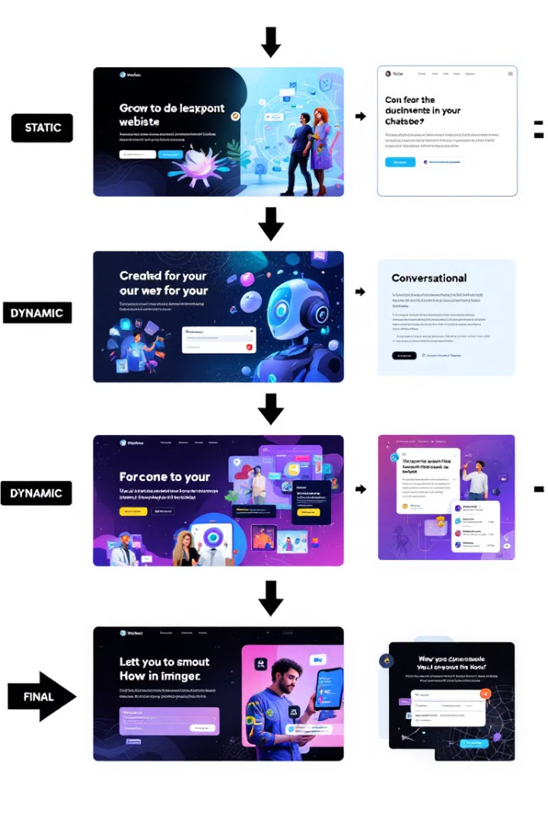
Evolution of Websites
1
Static Websites (Online brochures, no interaction)
2
Dynamic Websites (Users can interact, make purchases)
3
Interactive Websites (Personalization, forms, recommendations)
4
Conversational Websites (Real-time chatbots, AI assistants)

Slide 4
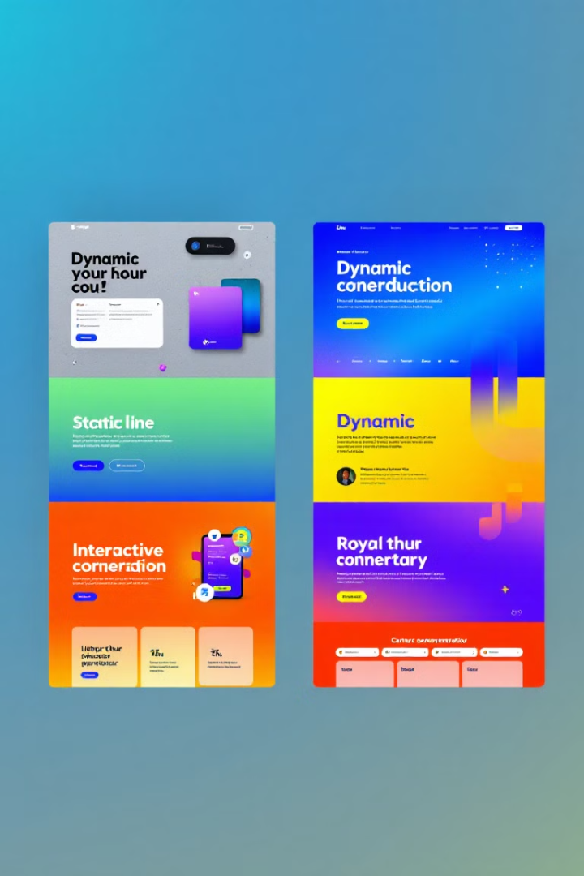
Examples of Website Evolution
Static Websites
Dynamic Websites
Simple pages with company info (e.g., early restaurant sites)
e.g. Amazon, UberEats (enabled transactions)
Interactive Websites
Conversational Websites
e.g. Netflix, Starbucks (personalized content)
Sephora chatbot (AI-driven recommendations) AIQoD360

Slide 5
Why Interactivity Matters for Startups
1
Interactivity is key to conversions
2
Real Estate Chatbot
Helps guide users based on budget and location.
Example: An e-commerce chatbot assists in product selection → increased sales.

Slide 6
Advanced Interactive Features
Gamification
Multilingual Support
Data Collection
Real-Time Assistance
Quizzes, spin-the-wheel promotions (e.g., Duolingo)
AI-driven translations (e.g., Booking.com)
Polls, surveys for insights (e.g., Nike personalized workouts)
AI chatbots reduce drop-offs (e.g., Shopify live chat)

Slide 7
Why Your Website Needs to Talk
1
Faster Responses
2
Higher Engagement
3
Improved Customer Satisfaction
Example: A fitness website directing users to relevant content.

Slide 8
Introducing Chat Genie
Chat Genie is our AI-driven chatbot for website transformation.
Features
Instant query responses
Product recommendations
Lead collection & CRM sync

Slide 9
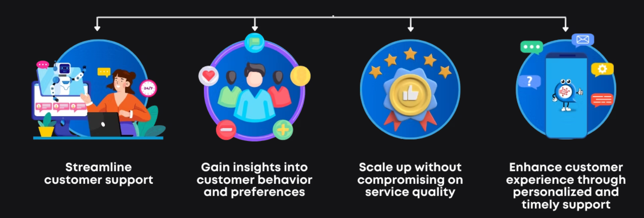
Chat Genie will
30%
25%
Sales Increase
Bounce Rate Reduction
Small retailer reduced cart abandonment.

Slide 10
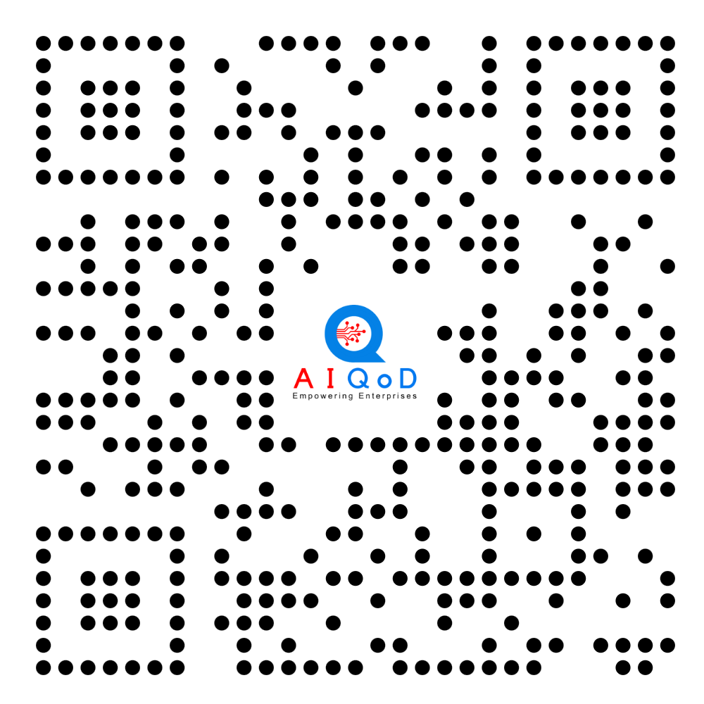
Thank You
For more information,
visit www.aiqod360.com

