Slide 1
GANESH ENGINEERING
36/2,DHANDEKAR INDUSTRIAL ESTATE
KONDHWA BUDRUK
PUNE-48
PHONE .020-65782140
Website-www.kganeshengg.in

Slide 2
PHONE:020-65782140 EMAIL:k.ganeshengg@rediffmail.com
WE INTRODUCE OURSELVES AS ,MANUFACTURERS OF SERRATED JAWS FOR
HYDRAULIC CHUCKS OF ANY MAKE,TURRET
SLEEVES,PULL STUDS AND MACHINING FOR
PRECISSION COMPONENTS ON CNC TURNING, 3D MACHINING ,DIES AND MOULD DESIGN AND MANUFACTURE
VMC,MILLING,LATHE ,DRILLING & TAPPING
COMPONENTS

Slide 3
OUR CUSTOMERS
1.KLAUS UNION
2.RANDACK FASTENERS
3.ARTUR SCHADE STEEL PRODUCTS
4.WORLDWIDE OILFIELDS MACHINE
5.BHARAT FORGE
6.VULKAN ENGG PVT.LTD.
7.WESTERN INDIA FORGING LTD.
8.C-TECH ENGRS PVT.LTD

Slide 4
MACHINE LIST
CNC MACHINES
1.VMC-BEAVER MAKE
550X850X400
2.VMC-JYOTI MAKE
820X520X520
3.CNC TURNING-SEIKI MAKE
DIA350X450
CNC TUTNING JYOTHI-DIA350X540
WE HAVE INSTRUMENT FOR
CHECKING
CONVENTIONAL
1.MILLING MACHINE
850X250X450.UNIVERSAL
2.LATHE DIA200X500
3.DRILLING MACHINE DIA 38MM
3D MACHINING SOFTWARE CAM WORKS
SWISS TYPE SLIDING HEAD CNC M/C 5AXIS 10000RPM

Slide 5
VTL JAWS

Slide 6
Implant screws

Slide 7
VTL JAWS

Slide 8
VTL BASE JAW

Slide 9
VTL BASE JAW ASSEMBLED DIA1200MM
BASE JAW FOR VTL CHUCK DIA 1200MM

Slide 10
VTL JAWS
VTL BOX TYPE JAW

Slide 11
RECTANGLE TUBE BENDING MACHINE
Radius forming for rectangle tube for structures

Slide 12
HYDRAULIC CHUCK

Slide 13
SERRATED JAW
Serrated jaws

Slide 14
GEAR TRAIN

Slide 15
ACTUATOR FOR BARC THROUGH RKENTERPRISE
Sliding attachment for inspection for BARC

Slide 16
ROLLER ASSEMBLY FOR BENDING

Slide 17
CYLINDER CAP FOR DEFENCE

Slide 18
PULL STUD
PULL STUD

Slide 19
TURRET SLEEVE
ALL SIZES OF TURRET SLEEVES ARE AVAILABLE

Slide 20
COMPONENTS FOR BALL VALVE,JAWS,TURRET SLEEVES AND DEFENCE COMPONENTS

Slide 21
COMPONETS FOR BALL VALVE

Slide 22
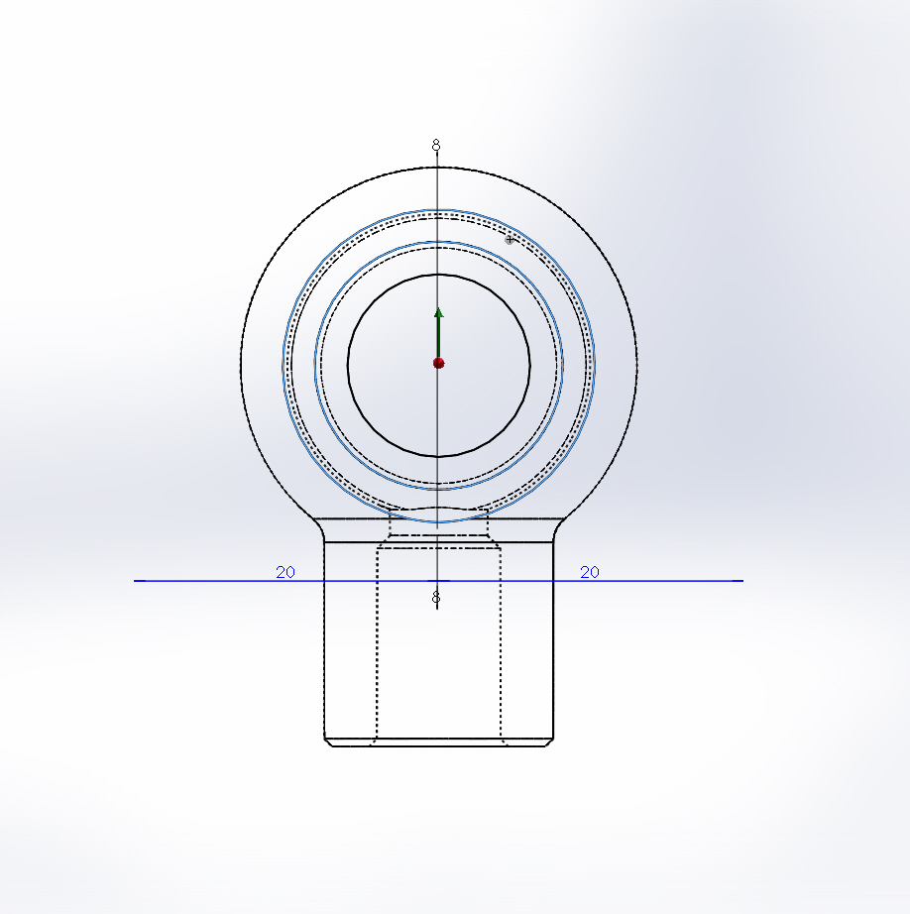
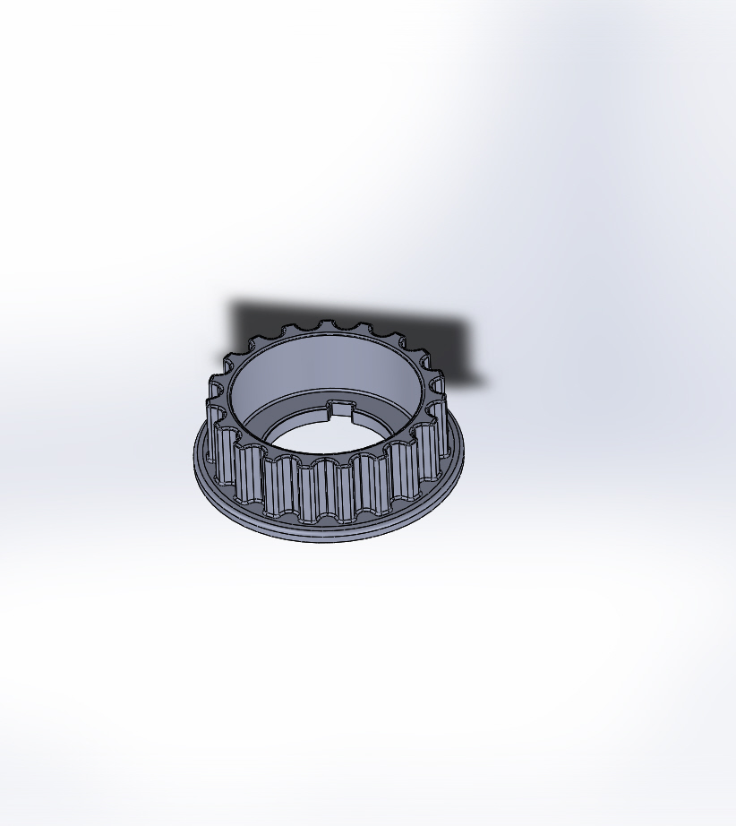

Slide 23
Solar project officers from REEEP AUSTRIA and TERI INDIA WITH GANESH ENGINEERING TEAM AND FUTURE PUMPS

